Slide 1


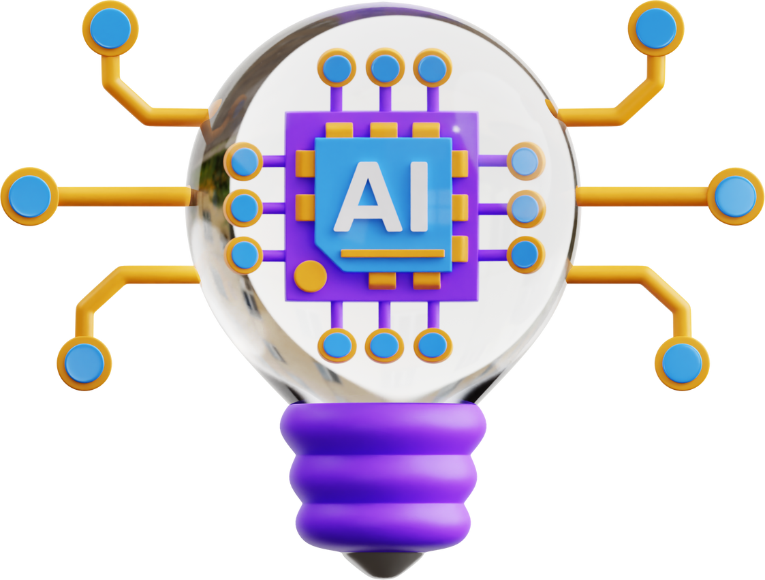

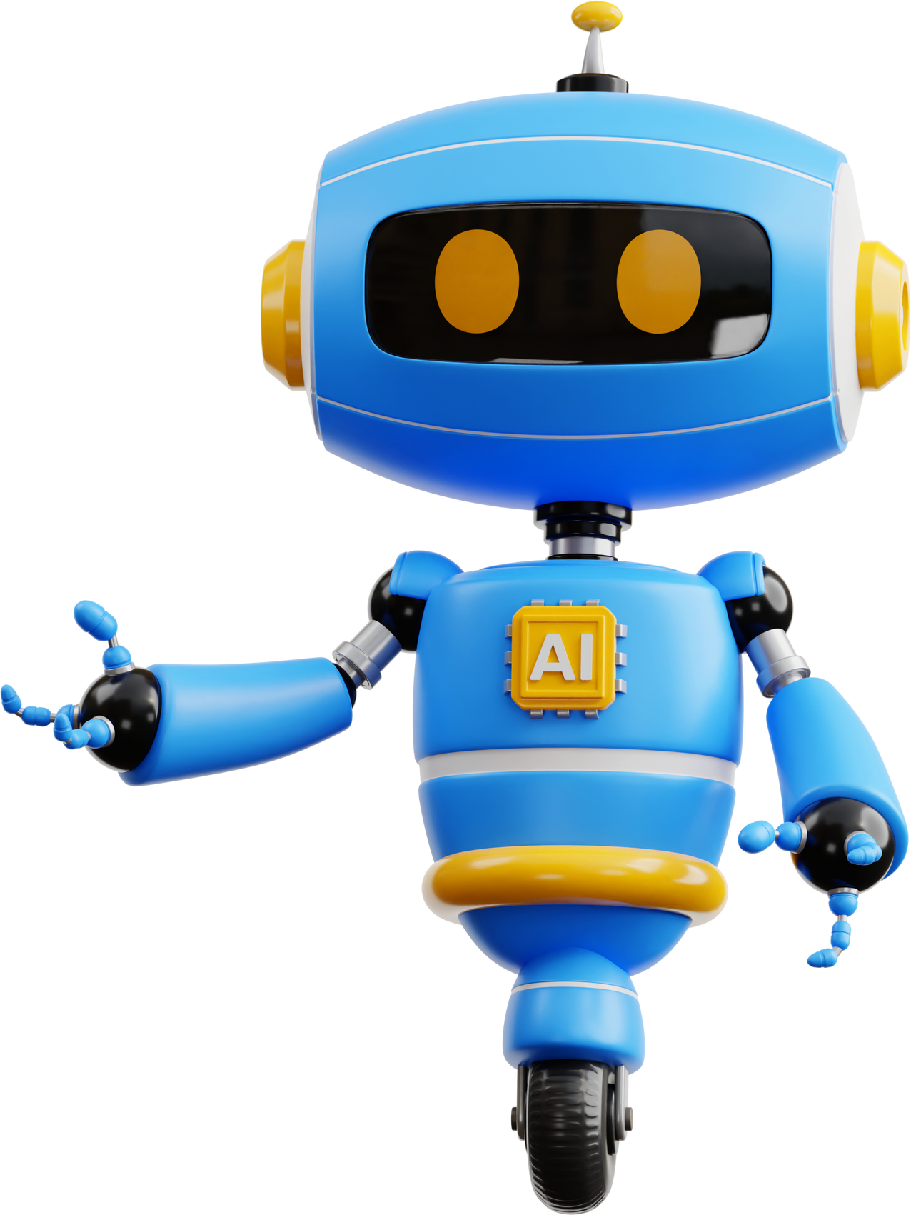

The Issue of
Artificial Intelligence
Philosophy and Current Studies (ULRS 1002 )
Group 4

Slide 2


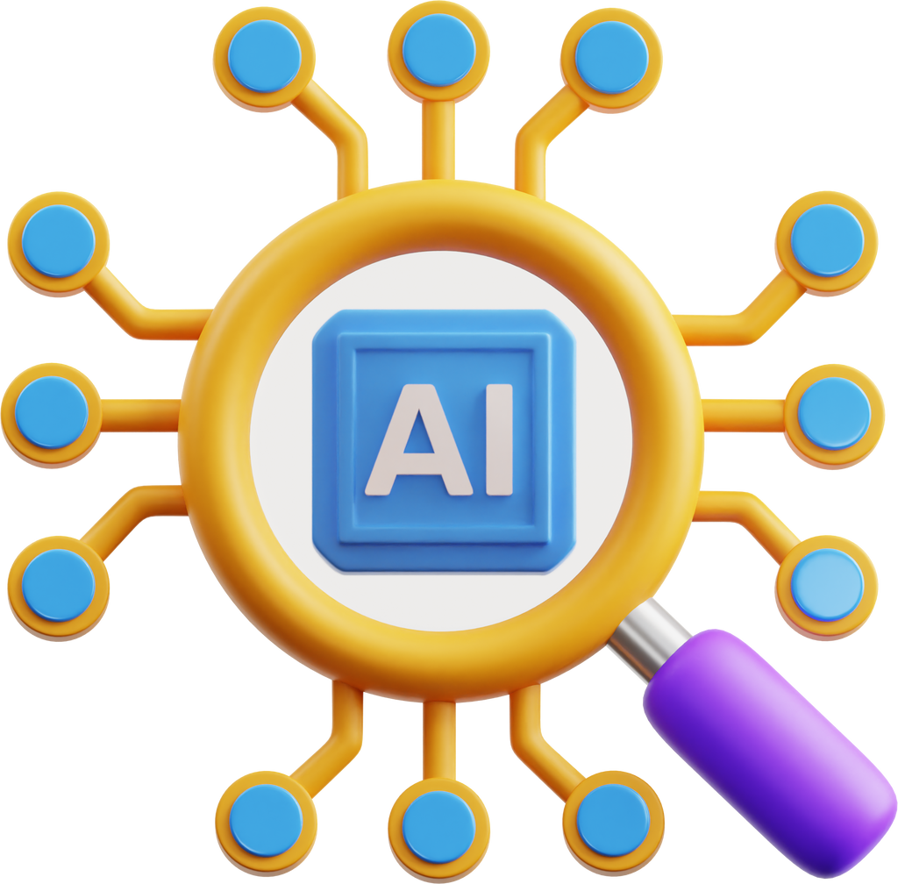
Group Members
Arnob Rizwan Ahmad-A22EC4005
Mohammad Areeb-A22EC4035
Devinda Weerasingha-A22EC5005
Omar-A22EC4012
Khaled Tahoon-A22EC4033
lECTURER:DR.NUR IZZATI BINTI MOHAMMAD NORZILAN

Slide 3
Table of contents
Introduction
Causes and factors of Ai
Study and Relation
Views of Figure
Impacts in the real world
suggestions regarding impacts
Conclusion
References

Slide 4


Introduction
Artificial intelligence is the simulation of human intelligence in a machine.These systems learn from vast amounts of data and can perform tasks that would otherwise require human intelligence. AI systems can be designed to analyze data, make decisions and adapt to new inputs and situations just as a human would perfom these tasks but in a much efficient manner.

Slide 5



Factors of Ai
Technological Advancements
Innovations in Algorithms: Machine learning, neural networks, and deep learning advancements have greatly enhanced AI's capabilities.
Example: DeepMind has achieved significant breakthrough in NLP
Increased Computational Power: Advances in hardware, such as GPUs and TPUs, have made processing large datasets more efficient.
Example: NVIDIA's GPUs are integral to training complex AI models.
Increasing Data Availability
Big Data: The massive amounts of data generated by digital activities are crucial for training AI models.
Example: Social media platforms like Facebook and Twitter generate vast amounts of data used to understand user behaviour.
Data-Driven Insights: AI systems utilize big data to make accurate predictions and decisions.
Example: In healthcare, AI models analyze patient data to predict disease outbreaks or recommend treatments.

Slide 6


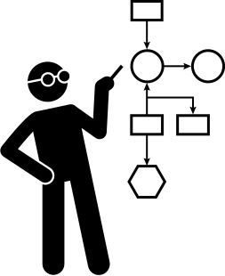
Factors of Ai
Demand for Automation
Efficiency and Productivity: AI-driven automation can perform repetitive tasks faster and with fewer errors than humans.
Example: AI-powered robots in manufacturing assemble products with precision, reducing costs and increasing output.
Operational Efficiency: Automation in sectors like finance, where AI handles trading, fraud detection, and customer service.: Automation in sectors like finance, where AI handles trading, fraud detection, and customer service.
Example: AI algorithms in finance optimize trading strategies and detect fraudulent transactions.
Need for Robust Regulatory Frameworks
Legal and Ethical Standards: Regulations ensure AI is developed and used responsibly.
Example: The EU’s GDPR impacts how AI systems handle personal data.
Safety and Accountability: Automation in sectors like finance, where AI handles trading, fraud detection, and customer service.
Example: The proposed EU AI Act aims to create a legal framework for AI development and usage.

Slide 7
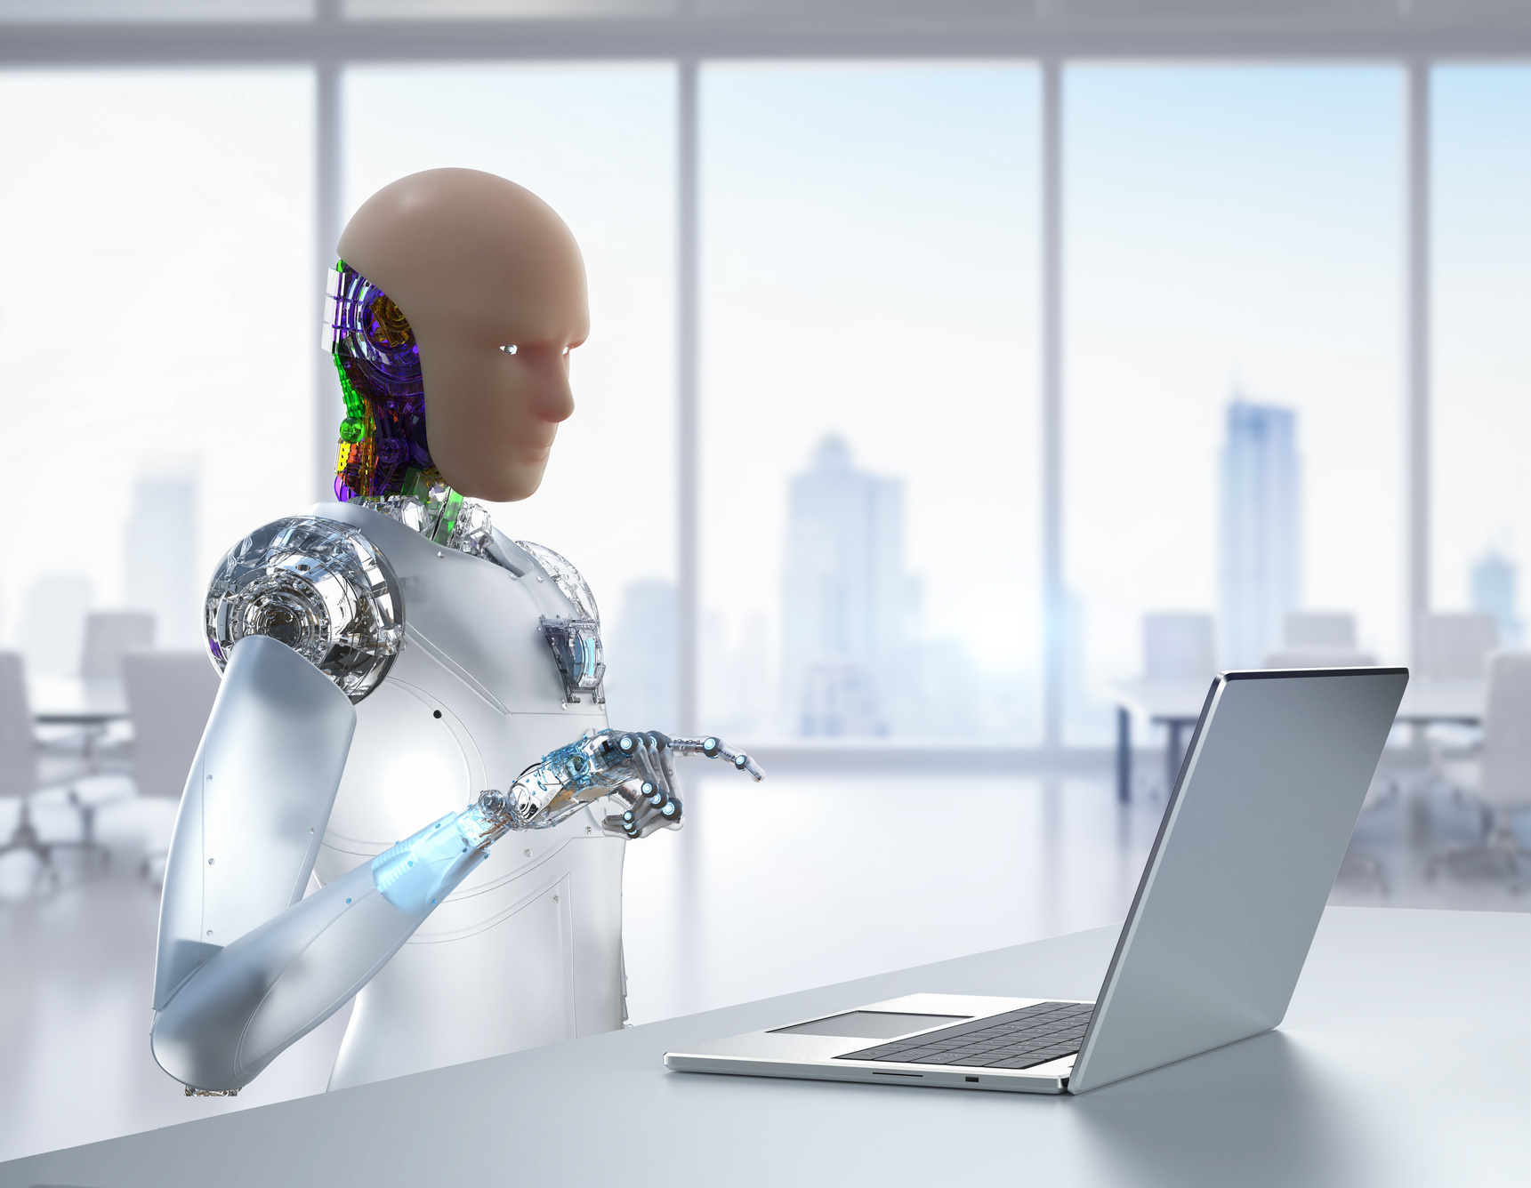

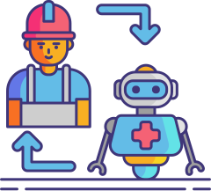
Challenges Regarding Ai
Ethical Considerations
Bias and Fairness: AI algorithms can inherit biases from their training data, leading to unfair outcomes.
Example: Facial recognition technology has faced criticism for racial bias and privacy issues.
Privacy Concerns: AI systems require vast amounts of personal data, raising privacy concerns.
Example: The EU’s GDPR sets guidelines on how AI systems handle personal data.
Potential Job Displacement
Automation of Routine Tasks: AI and automation threatens to displace jobs involving repetitive tasks.
Example: Self-driving cars could reduce the need for human drivers.
Reskilling and Upskilling: The workforce needs new skills to adapt to AI development and maintenance.
Example: Call centre jobs replaced by AI-driven customer service bots necessitate retraining.

Slide 8
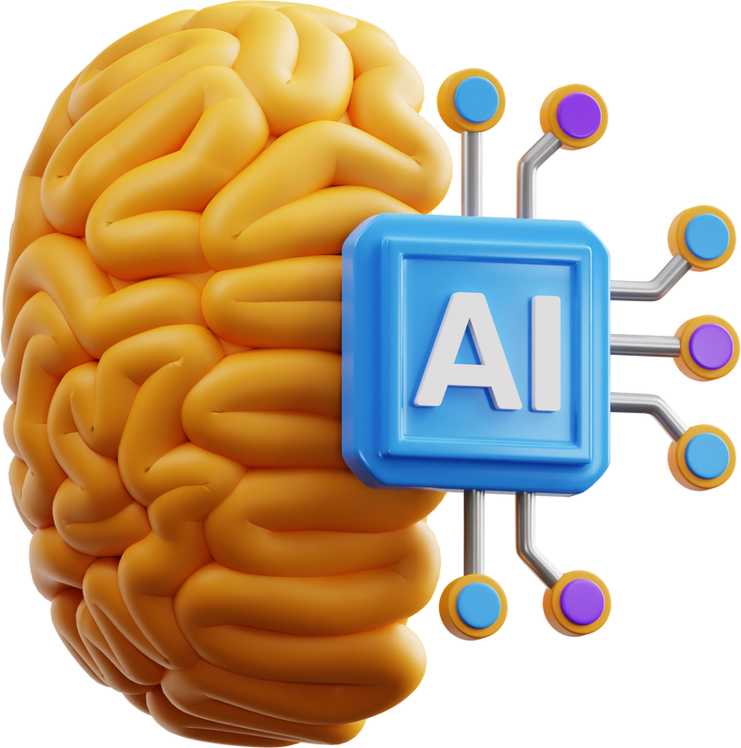
Study and Relation to Elements Philosophy
From a philosophical perspective,we can find various views:
Existentialism
Agency
Critical Thinking
Cultural Relativism
The emergence of AI prompts questions about the essence of human existence and purpose in a world increasingly shaped by intelligent machines.
AI systems' increasing autonomy and decision-making capabilities raise questions about the nature and extent of their agency in the world.
The increasing sophistication of AI raises questions about whether machines can truly think critically like humans.
The increasing reliance on AI in cultural contexts raises questions about the preservation and authentic representation of diverse cultural identities.

Slide 9
Philosophy of National Education

Slide 10
Embracing AI for a Future-Ready Malaysia: Nurturing Critical Thinking and Empowering Responsible Citizens
Empowering Responsible Citizens through AI
The integration of AI in Malaysian education presents a unique opportunity to cultivate critical thinking skills and empower future generations of responsible citizens. By incorporating AI-powered tools and resources, educators can foster an environment where students develop the ability to analyze information, evaluate evidence, and make informed decisions. AI can also be leveraged to personalize learning experiences, catering to individual student needs and promoting deeper engagement with complex topics. Through carefully designed curricula and ethical guidelines, Malaysian educators can ensure that AI is used not just as a technological tool, but as a catalyst for intellectual growth, social responsibility, and national progress.
By integrating AI into civic education, Malaysia can empower its students to become responsible and informed citizens. AI-powered tools can provide students with access to diverse perspectives, accurate information, and opportunities for civic engagement. Through simulations and interactive platforms, students can explore complex social and political issues, analyze data, and develop critical thinking skills essential for responsible decision-making. By fostering digital literacy and media awareness, AI can equip students with the tools to discern misinformation and participate in constructive dialogue. Ultimately, AI-powered education can empower Malaysian youth to actively contribute to their communities and shape the future of their nation.

Slide 11
National Pillars
RUKUN NEGARA

Slide 12
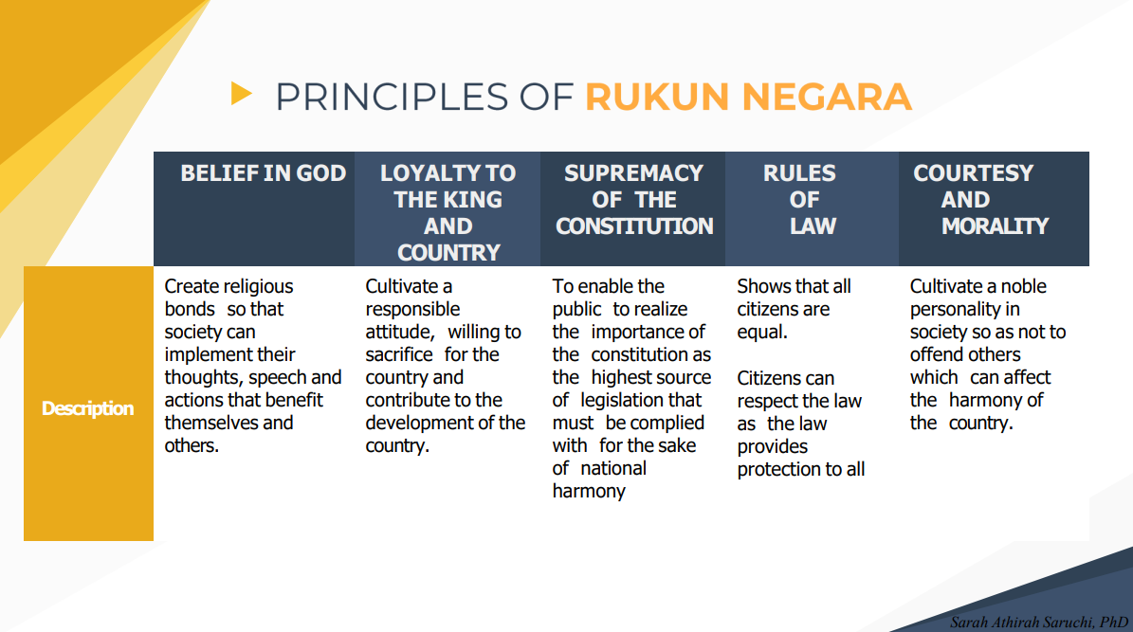
In the context of RUKUN NEGARA the principles of issue of AI related to fourth and fifth pillar.Here’s how they relate to pillar:

Slide 13
Kedaulatan Undang-Undang (Rule of Law)
It is very important to follow the Rukun Negara principles of "Kedaulatan Undang-Undang" (Rule of Law) and "Kesopanan dan Kesusilaan" (Courtesy and Morality) when putting AI into Malaysian schools. This makes sure that AI is used in a way that follows the law, is moral, and is accountable. It also promotes respect for human dignity, fairness, and good ideals in education. In the end, this method protects students' rights and creates a welcoming, peaceful learning space that is improved by AI technology.
Kesopanan dan Kesusilaan (Courtesy and Morality)
IT uphold the Rukun Negara principle of "Kesopanan dan Kesusilaan" (Courtesy and Morality), the integration of AI in Malaysian education must prioritize respecting the dignity and autonomy of students. This entails avoiding the use of AI for surveillance or control and ensuring student input in data usage. Furthermore, AI algorithms should be designed and implemented fairly, avoiding discrimination based on personal characteristics. Leveraging AI to promote positive values like empathy, collaboration, and critical thinking through facilitated discussions and personalized feedback further enhances the ethical and responsible use of AI in education, ultimately benefiting all students.

Slide 14
Physical, Emotional, Spiritual, and Intellectual Concepts
Physical (Jasmani)
Emotional (Emosi)
Spiritual (Rohani)
Intellectual (Intelektual)
The development of autonomous weapons poses significant risks to human life and international security due to their potential for unintended harm and lack of human accountability.
AI-powered surveillance systems can intrude upon individual privacy and personal freedoms, leading to potential misuse and abuse of personal data.
AI's ability to simulate empathy raises questions about the authenticity of emotions expressed by machines and the potential for human-machine emotional connection.
The use of AI to manipulate human emotions for commercial or political gain raises ethical concerns about autonomy, consent, and the potential for exploitation.
The increasing use of AI in religious practices raises concerns about the potential loss of human connection, authenticity, and the unique role of religious leaders in providing spiritual guidance.
The use of AI in spiritual guidance raises ethical dilemmas surrounding the authenticity of emotional support, potential biases in algorithms, and the appropriate boundaries for AI involvement in personal spiritual matters.
The rise of AI-generated content raises concerns about the potential devaluation of human creativity and the originality of intellectual output.
AI systems risk perpetuating and amplifying existing biases, hindering the development of critical thinking and unbiased societal perspectives.

Slide 15
Sir Ken Robinson: "Creativity is as important now in education as literacy, and we should treat it with the same status."
Stephen Hawking: "The development of full artificial intelligence could spell the end of the human race."
View of Figures

Slide 16
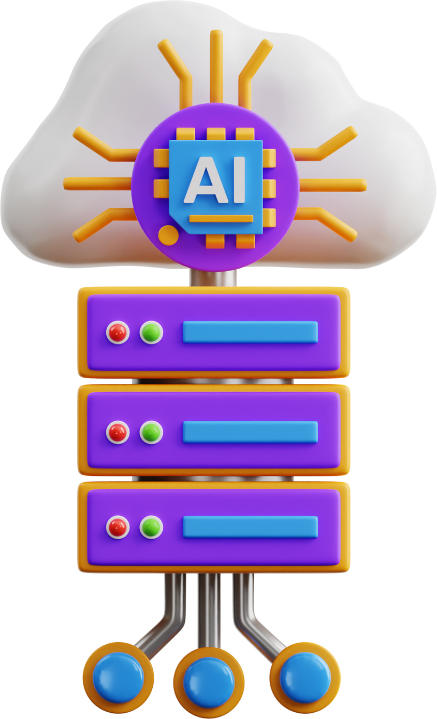
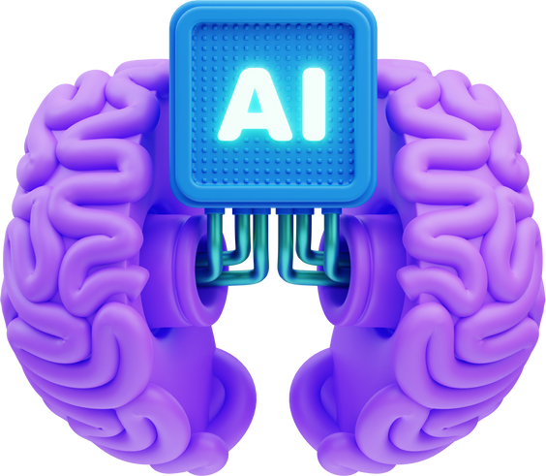
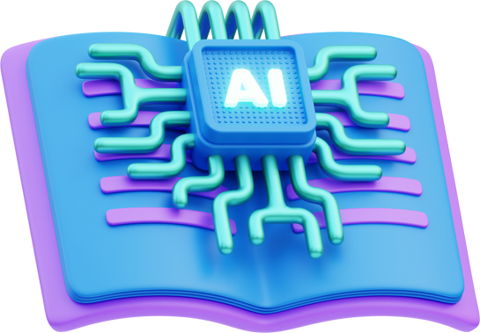

Impact in individual level
Employment and Economic Impact:
AI and automation could lead to job displacement for individuals in certain industries, requiring them to upskill or reskill to remain competitive in the job market.
Mental Health and Well-being:
The increasing use of AI in social media and online interactions could lead to feelings of isolation, anxiety, and depression in individuals, particularly those who struggle with social comparison or fear of missing out.
Privacy and Security Concerns:
The widespread collection and analysis of personal data by AI systems raises concerns about privacy breaches, identity theft, and the potential misuse of personal information, leading to increased vigilance and anxiety among individuals.

Slide 17
Impact in National and Community level
Economic Disruption
The widespread adoption of AI could lead to significant economic disruption in Malaysia, as automation displaces workers in various industries.
National Security Concern
The use of AI in cyberwarfare, disinformation campaigns, and autonomous weapons systems poses significant national security risks for Malaysia.
Social Inequility
The uneven access to AI technology and digital literacy could exacerbate existing social inequalities in Malaysia, creating a digital divide between those who benefit from AI advancements and those who are left behind.

Slide 18
Suggestion on how to deal with the issue

Slide 19

Ethical considerations:
Studying and relation: MIT research on algorithmic fairness has shown that unfavorable results can be reduced in AI systems by diversifying training data and using bias detection methods will carry out the function
Recommendation: Diversify training profiles and regularly evaluate AI systems to ensure they are adequate and use unbiased systems. Ensure transparency in AI decision-making processes to build trust and accountability.
Job Displacement:
Learning and networking: The World Economic Forum’s Future of Work report notes that while AI will displace some jobs, it will create new opportunities in technology and related fields.
Recommendations: Implement reskilling and upskilling programs to help employees adjust to the changing labor market. Encourage the development of new projects to support AI technology.
Legal Framework:
Privacy Concerns:
Research and relationships: A study by the University of California, Berkeley, on data privacy highlights the importance of strong data protection regulations and privacy protection technologies
Recommendations: Strengthen data protection laws and implement strict guidelines on how AI systems handle personal data. Encourage the development of privacy-protecting AI technologies.

Slide 20
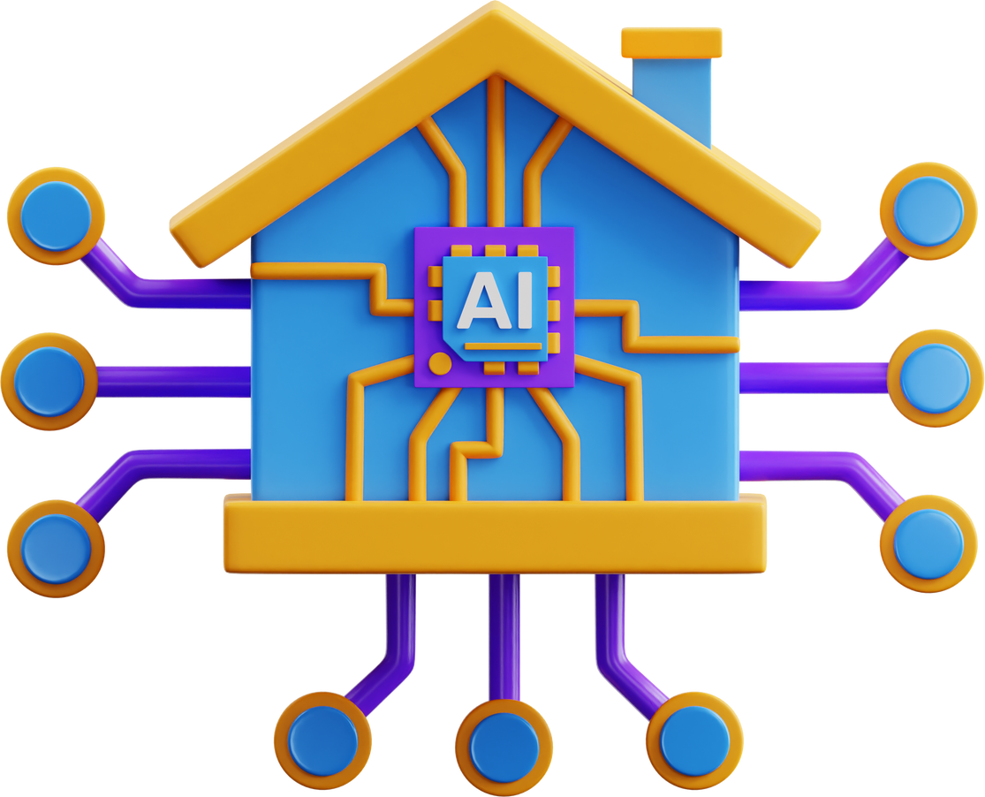
Conclusion
To conclude, whether AI is good or bad is undoubtedly complex.While AI contributes tremendously to solving complex problemsand enhancing the efficiency of time-consuming tasks, it also raises many social and economic concerns, such as job displacement,privacy issues and so on. Using ai responsibly and effectively can thrive human generation to it's next level.If not used the right way, in future, it might take a chance of being seen as the biggest enemy of humans. Therefore, we must find the right balance of using AI and not depending on it always.

Slide 21
References
Wikipedia contributors. (n.d.). Artificial intelligence. In Wikipedia, The Free Encyclopedia. Retrieved June 5, 2024, from https://en.wikipedia.org/wiki/Artificial_intelligence
Malaysia Government. (n.d.). Rukun Negara. Retrieved June 5, 2024, from https://www.malaysia.gov.my/portal/content/30110
ITRex Group. (n.d.). Artificial intelligence challenges. Retrieved June 5, 2024, from https://itrexgroup.com/blog/artificial-intelligence-challenges/
Müller, V. C. (Ed.). (2016). Fundamental issues of artificial intelligence. Springer. https://doi.org/10.1007/978-3-319-26485-1

Slide 22

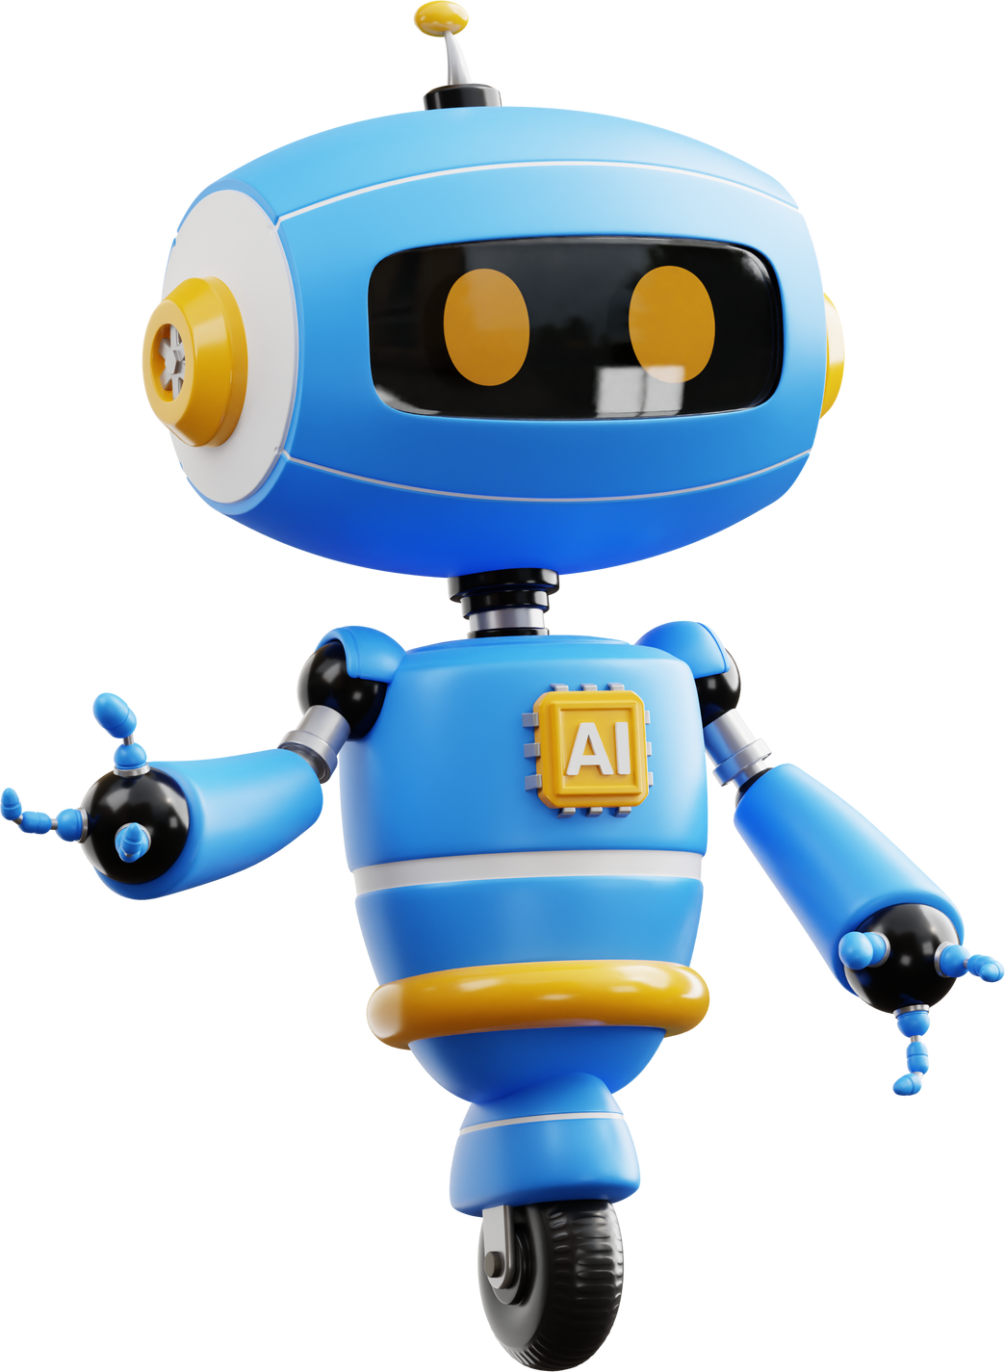
Thank You!

